Slide 1
Objectives
In this session, you will learn to:
  Handle events and exceptions

Slide 2
Handling Events and Exceptions
All the user interactions with the Web application such as clicking a button or a hyperlink are referred to as events.
These events need to be handled by the Web application to generate an appropriate response for the users.
JavaScript responds to these events by executing the appropriate code associated with it.
In addition, a Web page or application may contain errors or bugs that can be detected at compile time.
Such abnormal situations that occur in a code are known as exceptions.
To handle such exceptions, the Exception Handling mechanism is used.

Slide 3
Handling Events
In JavaScript, event is an action that happens on a Web page, such as a mouse click or loading of a Web page.
The Web browser waits for the event to occur, and when it occurs, performs the processing that has been programmed for the event.
For example, when a user clicks the OK button on a form, the Web browser executes a part of the code, which is designed to execute on that event. This is called event handling.
The function, which is executed in response to an event, is called an event handler.

Slide 4
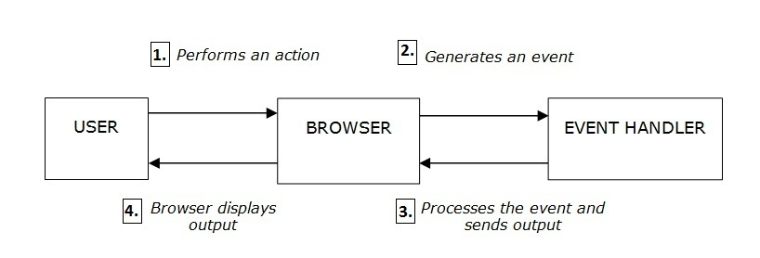
Handling Events (Contd.)
The following figure displays the event handling process.

Slide 5
Handling Events (Contd.)
The following table lists the various types of events supported in JavaScript.
Event | Description | Example
onblur | Event occurs when an element loses focus. | <input type="text" name=”textbox1” onblur="show()"/> where, show() is the function to be executed when the event occurs.
onchange | Event occurs when the content of a field changes. | <input type="text" id="fname" onchange="show()" /> where, show() is the function to be executed when the event occurs.
onclick | Event occurs when the user clicks an object. | <button onclick="show() ">Show Text</button> where, show() is the function to be executed when the event occurs.

Slide 6
Handling Events (Contd.)
Event | Description | Example
ondblclick | Event occurs when user double-clicks an object. | <button ondblclick="show() ">Show Text</button> where, show() is the function to be executed when the event occurs.
onerror | Event occurs when an error occurs while loading a document or an image. | <img src="image1.jpg" onerror="alert('Cannot load image.')">
onfocus | Event occurs when an element gets focus. | <input type="text" id="firstname" onfocus="alert('hello')"; />
onkeydown | Event occurs when any key of the keyboard is pressed. | <input type="text" onkeydown="alert('key is down')"/>

Slide 7
Handling Events (Contd.)
Event | Description | Example
onkeypress | Event occurs when a character key of the keyboard is pressed or held down. | <input type="text" onkeypress="alert('key is pressed')"/>
onkeyup | Event occurs when a keyboard key is released. | <input type="text" onkeyup="alert('key is released')"/>
onload | Event occurs when a page or image has finished loading. | <body onload="load()"> where, load() is the function to be executed when the event occurs.
onmousedown | Event occurs when the mouse button is pressed. | <img src="image11.gif" onmousedown="alert('You clicked image11!')">
onmousemove | Event occurs when the mouse is moved. | <img src="image11.gif" onmousemove="alert('You moved your mouse over image11!')">

Slide 8
Handling Events (Contd.)
Event | Description | Example
onmouseout | Event occurs when the mouse is moved off an element. | <p onmouseout="alert('Mouse moved out of the paragraph')"> Move the mouse pointer out of my paragraph to display an alert box.</p>
onmouseover | Event occurs when the mouse is moved over an element. | <p onmouseover="alert('Mouse moved over the paragraph')"> Move the mouse pointer over me to display an alert box.</p>
onmouseup | Event occurs when the mouse button is released. | <img src="image11.gif" onmouseup="alert('You clicked image11')" />
onselect | Event occurs when a text is selected. | Select text: <input type="text" value="Select me!" onselect="alert('You have selected the text.')" />
onunload | Event occurs when the user exits the page. | <body onunload="alert('The page is unloaded')">

Slide 9
Handling Exceptions
The exception handling mechanism:
  Allows a Web developer to generate and display customized error messages that can assist a user in resolving the error.
  Can be implemented in a JavaScript file using the
  try-catch block and throw statement.

Slide 10
Handling Exceptions (Contd.)
The try-catch block provides a mechanism to monitor the code that may generate an exception during runtime.
  The try block consists of the code that may generate an error.
  The catch block is used to handle the exception that may be generated during the execution of the code written within the try block.
The following syntax is used for declaring the try-catch block:
  try
  {
  Code that may generate an exception goes here
  }
  catch(error)
  {
  //Code to execute if an exception is thrown by the try block }

Slide 11
Handling Exceptions (Contd.)
The throw statement:
  Is used to throw an exception for an abnormal situation or error.
  Syntax:
  throw “exception”;
  For example:
  ...
    try {
    var fname = document.getElementById
    ("txtbox1").value;
    var lname = document.getElementById
    ("txtbox2").value;
    var age = document.getElementById("age").value;
    var address = document.getElementById
    ("address").value;

Slide 12
Handling Exceptions (Contd.)
  var gender=document.getElementById("gender").value;
  if ((isNaN(age)==true)||(age=="")||(age<=0)){
  throw "Incorrect_age";
  }
  else
  {
  confirm("You have entered:" + "\n Name : " + fname + " " + lname + "\n Age : " + age + "\n Address : "+ address + "\n Gender : "+ gender);}
  }
  catch(Incorrect_Age)
  {
  error_text="Incorrect Age Entered.\n";
  error_text+="Please verify.\n\n";
  alert(error_text);
  }
  }
  ...
Throwing Exception
Catching Exception and Displaying the Error Message

Slide 13
Demo: Adding Interactivity in Web Pages
Problem statement:
  The manager of the Web design team of the company BookYourShow Inc. has asked his designer to implement a functionality using which the schedule of a movie can be displayed dynamically. When a user selects a movie from a drop-down list on the Web page, the customer should be able to view the schedule for that particular movie. In addition, the Web page should accept the number of tickets to be issued and then display the total cost for the tickets to the user. During the calculation of the ticket cost, if any error occurs on the Web page, an appropriate message should be displayed. Help the Web designer to implement these features on the Web page.

Slide 14
Demo: Adding Interactivity in Web Pages (Contd.)
Solution:
  To solve the problem, you need to perform the following tasks:
    Create the user interface.
    Calculate cost of the ticket.
    View the Calc_Cost page and verify the output.

Slide 15
Summary
  In this session, you learned that:
  In JavaScript, events are actions that occur as a result of user interaction with the Web pages or other browser-related activities.
  Exception handling mechanism allows a Web designer to generate and display customized error messages that can assist a user in resolving the error.
  Exception handling can be implemented in a JavaScript file using the try-catch block and throw statement.
  The try-catch block provides a mechanism to monitor code that may generate an exception during runtime.
  The throw statement is used to throw an exception for an abnormal situation or error that may be generated when the code written in the try block is executed by the browser.

